Slide 1
Health Sciences
The Beginning Path To A Healthcare Career

Slide 2
The Health Science curriculum provides the student with a foundation of knowledge at each of the three levels to prepare them to advance to the next.

Slide 3
Health care careers are one of the fastest growing groups in the U.S.

Slide 4
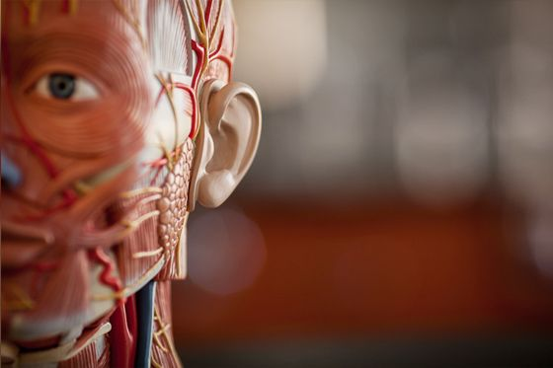
Health Science I
Beginning level that focuses on the human anatomy and physiology. Teaches students about the interaction of all of the body systems and the diseases that affect them.

Slide 5
Students in the Health Science I level learn things about how their bodies work and how diseases affect them.
Common Questions a Health Science I student can answer:
Did you know that a common cold is caused by a virus ?
Why do we sweat when we are nervous ?
How does exercise affect our heart rate?
Why do our joints pop ?
Learn what our heart sounds like :
https://www.youtube.com/watch?v=xS3jX1FYG-M

Slide 6
Health Science II

Slide 7
Health Science II is the level of explanation and exploration of the healthcare system and the careers that are available .
A Health Science II student begins to build a knowledge of todays healthcare system, how it works, and the many career opportunities that are available to them to pursue.
Students become knowledgeable about the amount of time it takes to achieve their career goals, how to achieve them and what it takes to become job ready.

Slide 8
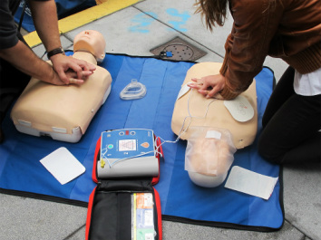
CPR certified
Health Science II students obtain their CPR and First Aid certification as part of the curriculum

Slide 9
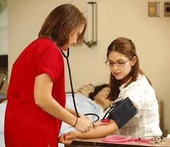
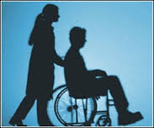
Health Science II students begin to learn basic patient care skills such as :
Learning to take a blood pressure
Taking basic vital signs
Transferring patients in wheelchairs and many more

Slide 10
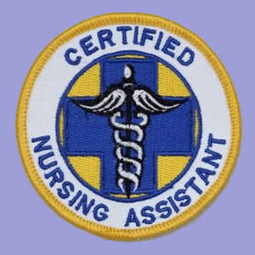
Nursing Fundamentals
Third class in the curriculum
Taken when students are seniors
Must have taken previous 2 courses
Consists of both classroom and clinical hours
When completed student can apply for and take the CNA state exam

Slide 11
Todays nursing and respiratory therapy schools are requiring that students applying to their programs must have a Certified Nursing Assistant certificate.
Highly competitive healthcare programs such as physical therapy, dental hygiene, and even some psychology classes require patient contact and a becoming a CNA is a great way to achieve this goal.

Slide 12
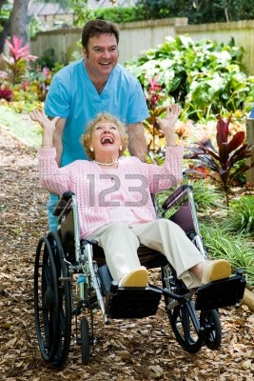
Students in Nursing Fundamentals take the knowledge and skills they have gained and work in a clinical setting where they can experience the hands on taking care of residents in a long term care facility. Many students begin to find out how rewarding a healthcare career can be and what satisfaction comes from taking care of others.

Slide 13
The Health Science curriculum is a beginning step into the world of healthcare and the knowledge, skills and compassion that are the trade marks of a healthcare worker.
https://www.youtube.com/watch?v=cDDWvj_q-o8

